Slide 3
Slow Down
“I shall walk carefully”
Isaiah 38:15

Slide 4
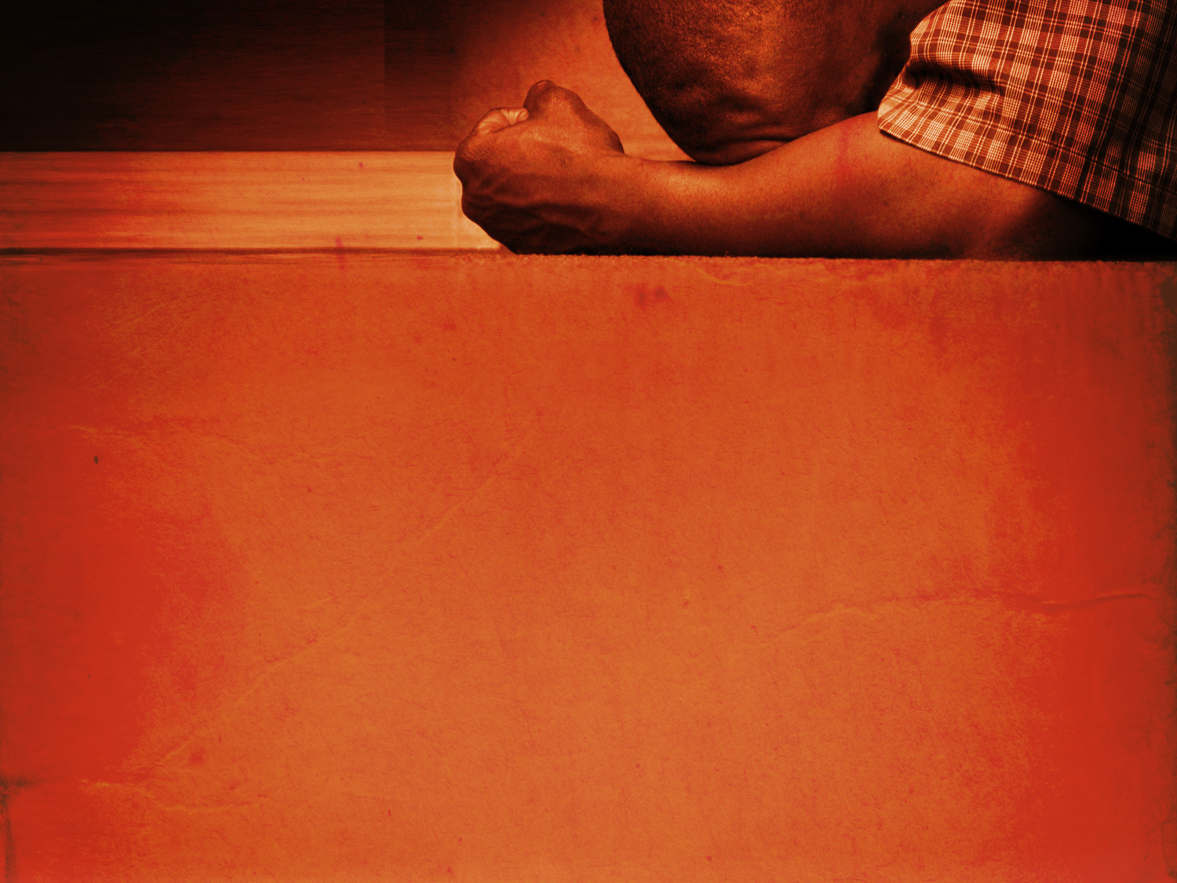
Slow Down
What was so important?
What were we missing out on?
What were we putting off until later?
What if “Later” never comes?

Slide 5
Take Care of Yourself
“by these things men live”
Isaiah 38:16

Slide 6
Take Care of Yourself
Physical Health – “You will restore me and make me live”
Spiritual Health – “the life of my spirit”

Slide 7
Forgive
“You have cast all my sins behind Your back”
Isaiah 38:17

Slide 8
Live for God
“Sheol cannot thank You”
Isaiah 38:18-19

Slide 9
Live for God
The living should Thank God
The living should Praise God
The living should Hope for God’s Truth
The living should Teach God’s Truth to children

Slide 10
Enter the House of the Lord
“in the house of the Lord”
Isaiah 38:20-22

Slide 11
Enter the House of the Lord
God’s House is His Church, today (1 Tim. 3:15)

Slide 12
The Gospel Is Your Second Chance
John 3:3-5 Galatians 3:27 2 Corinthians 5:17

