Slide 2
You’re Not God and That’s OK

Slide 3
FACT:
Incomprehensible Evil & Suffering Happens
You’re Not God and That’s OK

Slide 4
Incomprehensible To Us; But God is Infinite and Omniscient
Deuteronomy 29:29
The secret things belong to the LORD our God, but those things which are revealed belong to us and to our children forever, that we may do all the words of this law.
Hebrews 4:13
And there is no creature hidden from His sight, but all things are naked and open to the eyes of Him to whom we must give account.

Slide 5
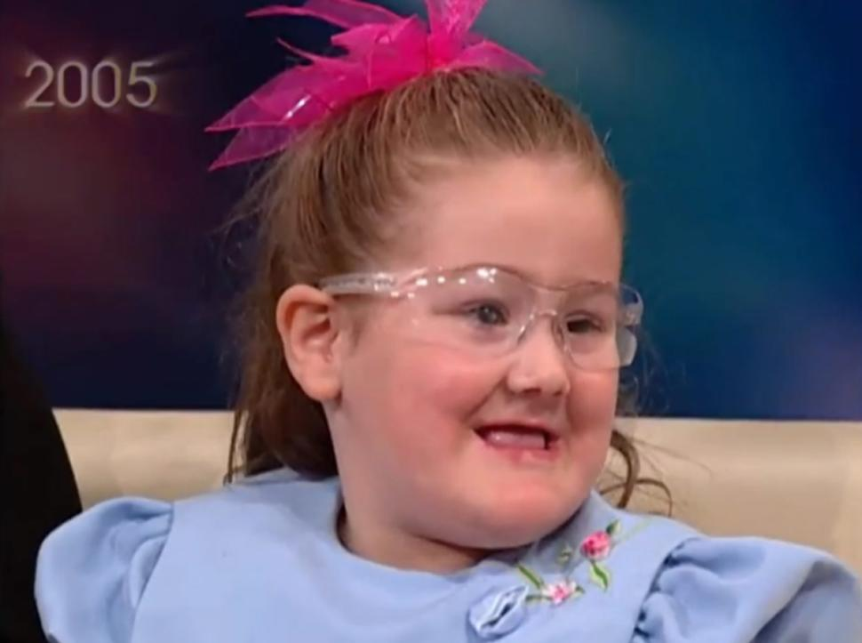
CHALLENGE:
Can we think of even one positive benefit of feeling pain?
Gabby Gringas, age 5
Congenital Insensitivity to Pain with Anhidrosis (CIPA)
You’re Not God and That’s OK

Slide 6
FACT:
God Does Not Always Behave Like Believers Think He Should
You’re Not God and That’s OK

Slide 7
God Surprised His People
Abraham & Sodom/ Gomorrah (Gen. 18:16-33)
Jonah & Nineveh (Jonah 4:1-2, 11)
Samuel anointing David (1 Sam. 16:1-13)
Ananias & Saul of Tarsus (Acts 9:10-16)

Slide 8
SUMMING UP:
Do You Deny Your Parents?
You’re Not God and That’s OK

Slide 9
FAITH:
Let God Be God Despite Evil & Suffering
You’re Not God and That’s OK

Slide 10
LET GOD BE GOD: Father
Matthew 7:9-11
Or what man is there among you who, if his son asks for bread, will give him a stone? Or if he asks for a fish, will he give him a serpent? If you then, being evil, know how to give good gifts to your children, how much more will your Father who is in heaven give good things to those who ask Him!

Slide 11
LET GOD BE GOD: Avenger
Luke 18:7-8
And shall God not avenge His own elect who cry out day and night to Him, though He bears long with them? I tell you that He will avenge them speedily.

Slide 12
LET GOD BE GOD: Sympathizer
Hebrews 4:15-16
For we do not have a High Priest who cannot sympathize with our weaknesses, but was in all points tempted as we are, yet without sin. Let us therefore come boldly to the throne of grace, that we may obtain mercy and find grace to help in time of need.

Slide 13
LET GOD BE GOD: Faithful
2 Timothy 2:12-13
​​If we endure,
​​We shall also reign with Him.
​​If we deny Him,
​​He also will deny us.
If we are faithless,
​​He remains faithful;
​​He cannot deny Himself.

Slide 14
IF WE DENY GOD: We are Impatient, We Are Not Eternal
James 5:10-11
My brethren, take the prophets, who spoke in the name of the Lord, as an example of suffering and patience. Indeed we count them blessed who endure. You have heard of the perseverance of Job and seen the end intended by the Lord—that the Lord is very compassionate and merciful.

Slide 15
IF WE DENY GOD: We are Impatient, We Are Not Eternal
Isaiah 40:31
But those who wait on the LORD Shall renew their strength; They shall mount up with wings like eagles, They shall run and not be weary, They shall walk and not faint.

Slide 16
IF WE DENY GOD: We are Judges, But Not Omniscient
Ecclesiastes 12:13-14
Let us hear the conclusion of the whole matter:
​
​​Fear God and keep His commandments,
​​For this is man’s all.
​​For God will bring every work into judgment,
​​Including every secret thing,
​​Whether good or evil.

Slide 17
IF WE DENY GOD: We Make Ourselves Idolaters
Isaiah 29:16
Surely you have things turned around! Shall the potter be esteemed as the clay; For shall the thing made say of him who made it, “He did not make me”? Or shall the thing formed say of him who formed it, “He has no understanding”?

Slide 18
IF WE DENY GOD: We Make Ourselves Idolaters
Isaiah 64:8
But now, O LORD, You are our Father; We are the clay, and You our potter; And all we are the work of Your hand.

Slide 19
FAITH:
We Are Not God But We Are God’s People
You’re Not God and That’s OK

Slide 20
Prayer – Talk to God
Habakkuk: Why do I see wicked? Why does God tolerate wrong? (Hab. 1:3)
David: Complaint about the wicked. (Ps. 64:1)
Jeremiah: Why does the way of the wicked prosper? (Jer. 12:1)
Job: I would know, I would understand all this as He understands. (Job 23:1-5).

Slide 21
Prayer – Talk to God
1 Peter 5:6
casting all your care upon Him, for He cares for you.
1 Timothy 2:1
Therefore I exhort first of all that supplications, prayers, intercessions, and giving of thanks be made for all men,

Slide 22
Stand Against Evil
Romans 12:17, 21
Repay no one evil for evil. Have regard for good things in the sight of all men… Do not be overcome by evil, but overcome evil with good.
Ephesians 5:11
And have no fellowship with the unfruitful works of darkness, but rather expose them.

Slide 23
Comfort the Suffering
2 Corinthians 1:3-4
Blessed be the God and Father of our Lord Jesus Christ, the Father of mercies and God of all comfort, 4 who comforts us in all our tribulation, that we may be able to comfort those who are in any trouble, with the comfort with which we ourselves are comforted by God.
James 1:27
Pure and undefiled religion before God and the Father is this: to visit orphans and widows in their trouble, and to keep oneself unspotted from the world.

Slide 24
Urgent Mission: Prepare Souls for Eternity
Colossians 1:28
Him we preach, warning every man and teaching every man in all wisdom, that we may present every man perfect in Christ Jesus.

Slide 25
Tragedy: Renouncing God Due To Evil, Pain, & Suffering
Personal Condemnation (Matt. 10:28, 32-33)
Wasted Potential for Good

Slide 26
You’re Not God and That’s OK

