Slide 1
“Go therefore and make disciples of all nations, baptizing them in the name of the Father and of the Son and of the Holy Spirit, teaching them to observe all that I have commanded you. And behold, I am with you always, to the end of the age.”
Matthew 28:19-20

Slide 2
“Go therefore and make disciples of all nations, baptizing them in the name of the Father and of the Son and of the Holy Spirit, teaching them to observe all that I have commanded you. And behold, I am with you always, to the end of the age.”
Matthew 28:19-20

Slide 3
WHAT
IS
A
DISCIPLE?

Slide 5
“By this my Father is glorified, that you bear much fruit and so prove to be my disciples.”
John 15:8

Slide 7
“It is written in the prophets, ‘And they will all be taught by God.’ Everyone who has heard and learned from the Father comes to me.”
John 6:45

Slide 9
“A new commandment I give to you, that you love one another: just as I have loved you, you also are to love one another. By this all people will know that you are my disciples, if you have love for one another.”
John 13:34-35

Slide 11
“Now Jesus did many other signs in the presence of the disciples, which are not written in this book; but these are written so that you may believe that Jesus is the Christ, the Son of God, and that by believing you may have life in his name.”
John 20:30-31

Slide 13
“So Jesus said to the Jews who had believed him, ‘If you abide in my word, you are truly my disciples.’”
John 8:31

Slide 18
“Pursue peace with all men, and holiness, without which no one will see the Lord.”

Slide 20
Lord’s Supper

Slide 21
Song
More Holiness
Give Me

Slide 24
Weekly Bible Classes
“It is written in the prophets, ‘And they will all be taught by God’… John 6:45

Slide 25
Weekly Bible Classes
Fall 2015
“The Bible at 10,000 Feet”
(Auditorium Anchor)
Epistles: James, 1st & 2nd Peter, Jude
“Building and Growing Your Godly Family”
(College Class)
“It is written in the prophets, ‘And they will all be taught by God’… John 6:45

Slide 26
New Service Teams
September 6
Livingston Families Adopt - a - Student

Slide 30
H2H Purpose
H2H meetings exist to develop more meaningful relationships that will prompt deeper connection and service to one another by mutually digging deeper in applying God’s Word to our lives.

Slide 31
Common Group
Program Problems
Growth limiting goals
Curriculum
Assigned friendships
Social/Spiritual goal tension
Unending commitment
No leadership training or support

Slide 32
H2H Meeting
Solutions
Growth limiting goals
Curriculum
Assigned friendships
Social/Spiritual goal tension
Unending commitment
No leadership training or support

Slide 33
H2H Meeting
Solutions
Unlimited growth goals
Curriculum
Assigned friendships
Social/Spiritual goal tension
Unending commitment
No leadership training or support

Slide 34
H2H Meeting
Solutions
Unlimited growth goals
Sermon based curriculum
Assigned friendships
Social/Spiritual goal tension
Unending commitment
No leadership training or support

Slide 35
H2H Meeting
Solutions
Unlimited growth goals
Sermon based curriculum
Voluntary Involvement
Social/Spiritual goal tension
Unending commitment
No leadership training or support

Slide 36
H2H Meeting
Solutions
Unlimited growth goals
Sermon based curriculum
Voluntary Involvement
Spiritual goals
Unending commitment
No leadership training or support

Slide 37
H2H Meeting
Solutions
Unlimited growth goals
Sermon based curriculum
Voluntary Involvement
Spiritual goals
Manageable commitment
No leadership training or support

Slide 38
H2H Meeting
Solutions
Unlimited growth goals
Sermon based curriculum
Voluntary Involvement
Spiritual goals
Manageable commitment
Leadership training and support

Slide 39
H2H Meeting
Benefits
Connection/Relationships
Leadership development
Improve sermon effectiveness
Provide next step in discipleship
Ground new members
Handle “issues”

Slide 40
H2H Meeting
Share
Study
Pray

Slide 41
H2H Meeting
Fall Session: September 13-December 6
Sign-ups begin August 23 (Next Sunday)

Slide 42
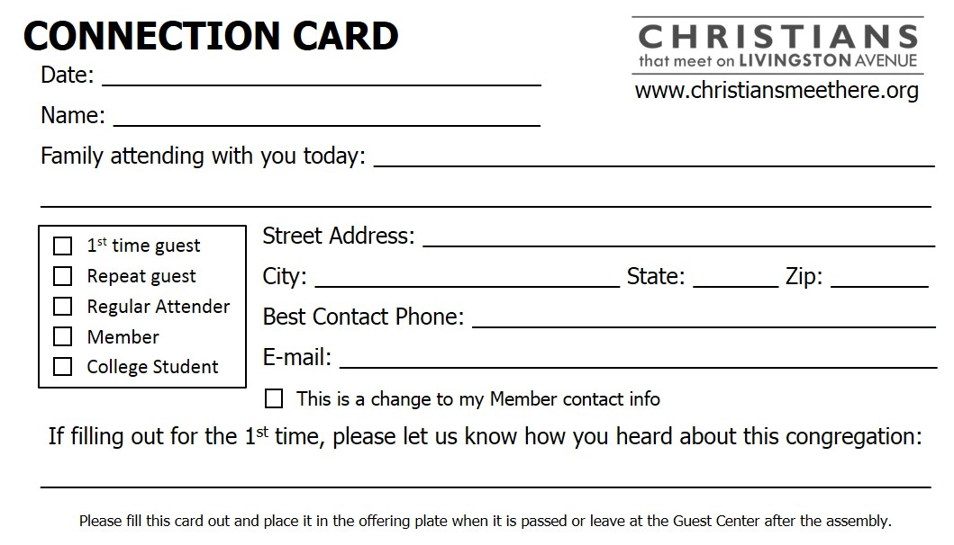
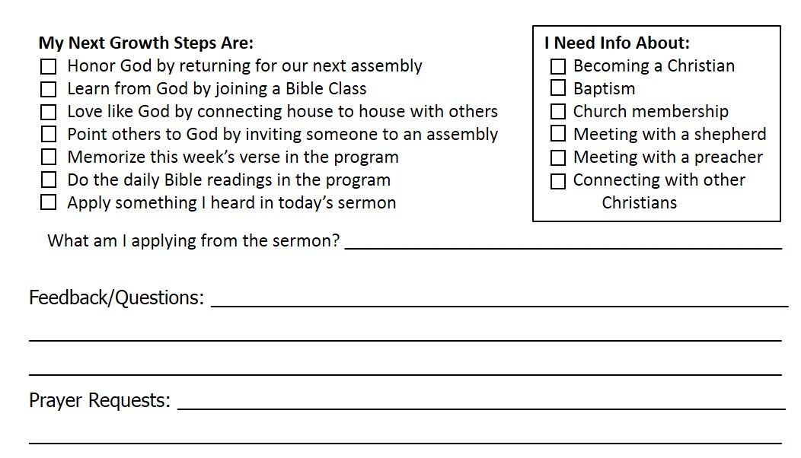
Connection Cards

Slide 43
Connection Cards
August 16, 2015
Joe Coca-Cola
Jane Coca-Cola, Joey Jr., Jason, Janice
12345 Main St.
X
X
Lutz
FL
33559
X
(813) 555-1234
X
Myemail@email.com
X
X
Johnny Christian invited me

Slide 44
Connection Cards
X
X
X
X
X
X
X
X
I want to pursue holiness more.
I was wondering…
I’d like…
I didn’t like…
Please pray for me as I try to pursue holiness more.

Slide 45
Connection Cards
August 16, 2015
Joe Coca-Cola
12345 Main St.
Lutz
FL
33559
(813) 555-1234
Myemail@email.com
X

Slide 46
Connection Cards
X

